Slide 1
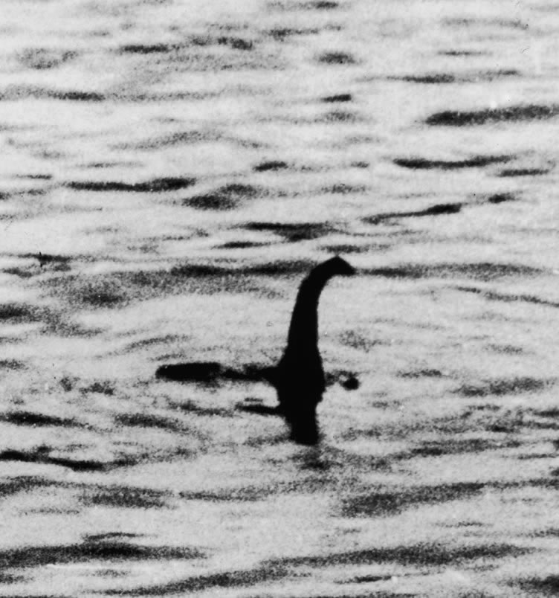


Part I Warm Up
Answer these questions with a partner.
Mysteries
1. Look at the photo. What do you know about the Loch Ness monster? Do you believe it exists?
2. Do you know any mysteries?
3. Do you believe there is life on other planets?
Two men took this photo of a monster in Loch Ness, Scotland, in 1934. Many years later, one of the men said that it was a fake.

Slide 2
Content Note
The Loch Ness monster, also called Nessie, is a creature that possibly exists in a lake in Scotland. Some people believe that Nessie is a dinosaur that survived extinction. The legend is mostly supported by eyewitness stories, but no proof has been found to show that Nessie really exists.
The photo from 1934 caused worldwide excitement about the monster. The photo appeared again and again in newspapers and books. However, sixty years later, it was found out to be a fake. Still, the mystery of Nessie brings many tourists to Loch Ness every year.

Slide 3
Language Note
The term mystery describes a situation in which we don’t know whether a story is true or not. For this unit, the word refers to unusual stories that seem untrue but might be true. They cannot be proven true or false, so they are mysteries.

